Slide 1
Transitional Protection
June 2023

Slide 2
What we’ll cover
Who’s affected
Key changes
What do you need to do
Questions you may be asked
Resources.

Slide 3
Transitional Protection 2015
Allowed some members to remain in final salary while others moved to career average
Members could either be:
Full protection, or
Tapered protection, or
Transition members.
The ‘remedy period’ is 1 April 2015 – 31 March 2022.
Notes:
Transitional protection allowed members, who were within ten years of their normal pension age, to remain in their final salary scheme, while other members moved to the new career average scheme on, or after, 2015
There are three categories members could fall within. These are: Full protection, Tapered protection and Transition members.
Full Protection
Active members within 10 years of Normal Pension Age (NPA) at 1 April 2012 remained in final salary
Tapered Protection
Tapered protection for members within a further 3.5 years of their NPA remained in final salary until a later date then move into career average
Transition members
Other existing members entered the career average scheme on 1 April 2015.

Slide 4
Affected and non-affected members
Affected members
Active members of the Scheme on 31 March 2012, with no ‘disqualifying break’ of more than 5 years ending after this date.
Have service in the remedy period
Non-affected members
First joined on or after 1 April 2012
Not in service 31 March 2015 or had a disqualifying break.
No service in the remedy period
Fully retired prior to 1 April 2015.
Notes:
Affected members:
Active members of the Scheme (or another public service pension scheme) on 31 March 2012
Have service in the remedy period (1 April 2015 – 31 March 2022)
Don’t have a disqualifying break of more than 5 years
Non-affected members
First joined one of the affected public service pension schemes on or after 1 April 2012
Not in service 31 March 2015 or had more than 5 year break ending on or after 31 March 2012
No service in the remedy period (1 April 2015 – 31 March 2022)
Members who took full benefits on or after 1 April 2012
Members who fully retired* and re-entered pensionable service after retirement, before 1 April 2012
* Fully retired (does not include phased retirement or where NPA 60 benefits taken, but NPA 65 service continued)

Slide 5
Stage 1 key changes – 1 April 2022
    From 1 April 2022 all active members accrue service in the career average scheme. All former ‘fully protected members’ joined career average.
    Final salary link will still apply for those with previous service in the final salary scheme (unless they have a break of more than five years)
Overtime and ‘excess service’ is pensionable, in career average only, from 1 April 2022
All members will have a normal pension age of either their state pension age or age 65, whichever is the later, for their career average pension.

Slide 6
Stage 2 key changes
Address the difference in treatment during the remedy period; legislation and administrative changes in place as of 1 October 2023
    An affected member chooses between final salary and career average benefits for service in the remedy period
    Where benefits have been taken prior to 1 October 2023, members or decision makers are required to make an ‘immediate choice’. Benefits in payment will continue until the choice is made or a ‘default’ is applied based on the highest monetary value.
    Where benefits have not been taken before 1 October 2023, members or decision makers will receive a choices document. These ‘deferred choice’ members will need to choose between final salary or career average before benefits can be paid.
Notes:
Affected members
*For deceased members, depending on circumstances, the decision maker may be the member’s personal representative, a surviving spouse or the parent or guardian of a child in receipt of a child pension. Where there is no decision maker, Teachers’ Pensions may act as the DM.

Slide 7
Overtime & flexibilities
Overtime
Pensionable in career average only
Flexibilities
Final salary scheme - additional pension
Career average scheme – additional pension, faster accrual and buy out
Remedy
Career average additional pension converted to final salary additional pension
Faster accrual and buy out in career average have three options:
      Converted to final salary additional pension, or
      Repaid as compensation with interest, or
      Retained and reinstated.
Notes:
Overtime
Not pensionable in final salary but pensionable in career average. Contributions to be deducted in respect of pensionable employment from 1 April 2022 and included in service & salary details
Flexibilities
Final salary scheme - additional pension
Career average scheme – additional pension, faster accrual and buy out
Remedy
Career Average additional pension converted to final salary additional pension or compensation
Faster accrual and buy out in career average will either be:
converted to final salary additional pension, OR
contributions repaid with interest as compensation, less tax less originally given, OR
compensation retained and the flexibility will be reinstated if career average benefits chosen.

Slide 8
Full-time/part-time service in LGPS/TPS
Final salary scheme
Where there is concurrent full-time and part-time teaching service, the part-time service isn’t pensionable in TPS. This excess teaching service will be pensionable in LGPS.
Career average
Issue of excess service doesn’t arise as all teaching employments is pensionable in the TPS.
The difference in treatment to be addressed after rollback.
Treatment of excess teacher service where the employer participated in LGPS
    Rolled back into the LGPS and subject to their rules for remedy period.
Subsequent Transfer option
    Excess service moved to LGPS can be transferred back to the TPS in accordance with transfer rules.
    Transfer window is one year from member receiving their Remediable Service Statement (RSS).
Non-pensionable service (employer was not an accepted LGPS employer).
Either take contributions as compensation or defer choice regarding this service until retirement.

Slide 9
Other policy updates
Change to SCAPE rate – this will be used in calculating employer contribution rate
Pensions Dashboard
Removal of Lifetime Allowance (LTA) charge for 2023/24 and LTA abolition from 6 April 2024
Increase in Annual Allowance to £60,000 for 2023/24
Revised Pension Saving Statements to be issued on account of the remedy

Slide 10
Teachers’ Pensions Action Forum June 2023
Communications

Slide 11
What are we doing in preparation?
    Bringing key staff together to work to understand changes
    Recruitment for new staff
    Mapping out changes to processes
    Developing IT systems to provide the options identified
    Working in partnership with the Department for Education
    Staff training
    Delivering communication on what we know so far
    Working with other Public Service Pension schemes.

Slide 12
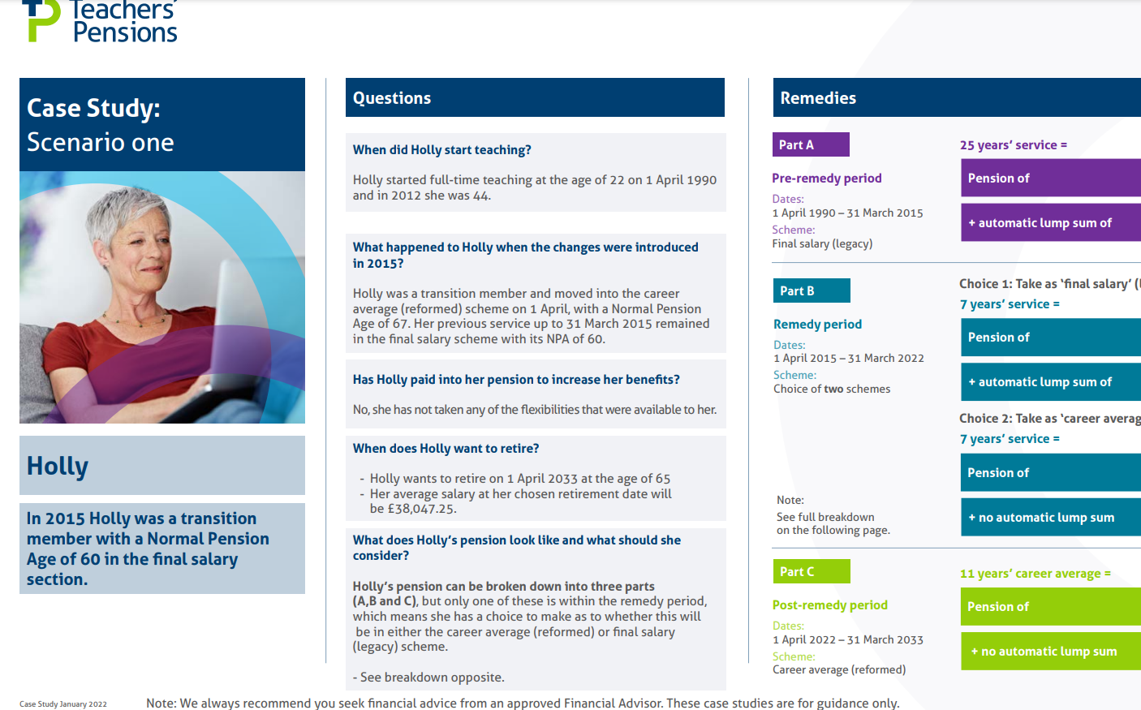
Communications and resources
Email / MPO / Direct mail
Bespoke web pages
Case studies
Social
Training
Videos
Social media.
Notes:
Am I affected?
What is transitional protection?
What do I do if I’m planning to retire?
What happens to my final salary benefits
How will I be given my options?
When will I be notified of the changes?
When will I see changes to my pension?

Slide 13
Two key resources for members
Decision Tree
    Affected / not affected
    DCU or rectification
    Service in another public sector pension scheme
    Whether they plan to retire before 1 October 2023
    Whether they have overtime or flexibilities
    MPO Banner (in My Pension online directing to information about how they are impacted)
    Affected DCU
    Not affected DCU
    Affected rectification
    Not affected rectification
    Transfers / divorce.
    These will updated once the consultation is complete and encourage members to revisit them.

Slide 14
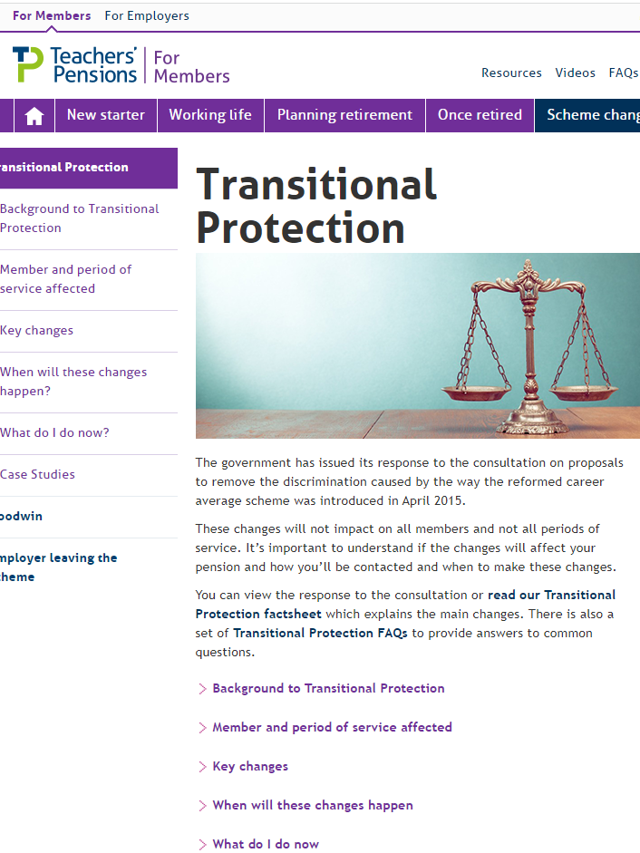
Employer key messages & resources
    Signpost members to information on our website
    Advise they should wait to be contacted by us directly
    Ensure member records are kept up to date
    Retain service and salary information in the event of future queries
    Training webinars.

Slide 15
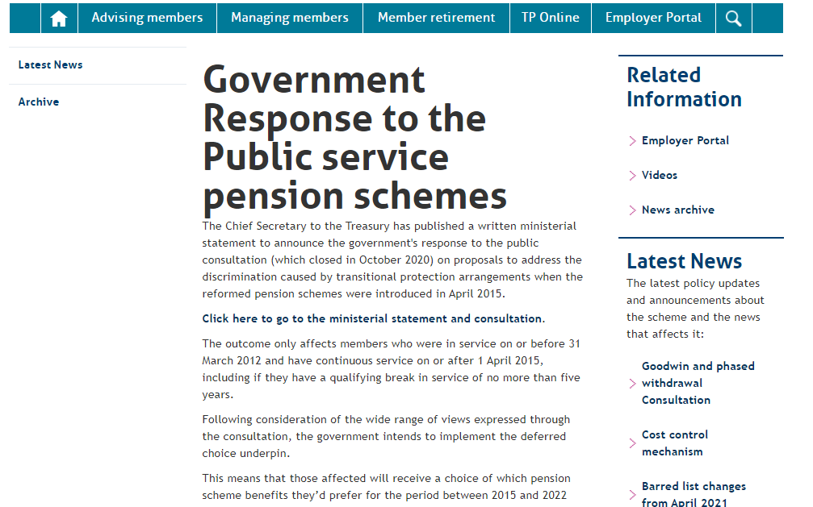
What you need to do?
No immediate action
For now, please signpost members to the comprehensive information (bulletins, factsheets, FAQs) we keep updated on our website
Continue to ensure that member records are kept up to date.
Retain service and salary information in preparation for future queries as members begin to make their choice.

Slide 16
What does a member need to do now?
Identify if they’re affected by the changes
Register with MPO
Wait for us to contact them
Keep up to date through information on the website
Check their service records are up to date and communicate with employers where not.
Key messages to staff – no worse off and getting a choice

Slide 17
Retirement process
Retirement Form
Employer Completion & TP Processing
Email to member & Secure message
Options Statements
Choices Form
Retired
Notes:
Member completes their part of the application form
Goes to the employer for them to complete their part of the application
TP then provides the options paper which shows the different calculations
Member completes the choices form to notify us of their chosen option
TP process application and put pension into payment
MD comment: The process is “paused” awaiting their FA or CA decision.
* Do we notify them that we have received their choice form and then send out a separate letter confirming their pension has been processed/will be put into payment or do we just write out with their pension amount

Slide 18
Thank you
Notes:
Slide for what the retirement process will be
Slide for what will happen to those who have retired – they will be contacted directly
Case study examples – practicalities (2 x basic / most popular and easy to explain
What we can’t advise you on until after the consultation – flexibilities/overtime/transfers/LGPS/Tax?
Resources – decision tree / MPO banner / calculator and modeller

