Slide 1
Teachers’ Pensions Action Forum June 2024
Employer Secure Messaging

Slide 2
What we’ll cover?
Introduction
Functions of secure messaging
Submitting queries
Updates since 2023
Demonstration.

Slide 3
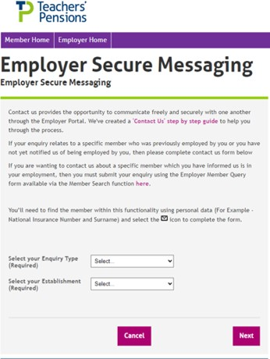
Introduction
Employer Secure Messaging provides you and Teachers’ Pensions with the opportunity to communicate freely and securely through the Employer Portal.

Slide 4
Functions of secure messaging
It allows you to:
Securely message us and provide attachments
Have a designated reference number for your specific query
See an audit trail of correspondence
Ask both employer and member queries (you must be the current employer for specific member queries).
It allows us to:
Securely message you with our queries
Respond to your enquiries.

Slide 5
Submitting queries
When sending a secure message there are different options to select from depending on the query that you have:
Submitting a general enquiry – for example if you need to know something on the MCR process or EOYC
Submitting a member specific enquiry (member search option) – about an employee who is currently employed in your establishment
Submitting a member specific enquiry for a member who hasn’t yet started at your establishment or has left employment – in these circumstances you would use the general enquiry format.

Slide 6
Updates since 2023
Thanks to feedback from Employers, we’ve now enhanced Employer Secure Messaging with the following features:
Notifications now able to send to multiple contacts within an establishment
Secure Messaging Categories Factsheet now available to assist employers in selecting the correct categories for their queries
We’ve created a new notification to inform employers when a query submitted under an incorrect category has been closed.

Slide 7
Demonstration
We’ll now take you through a demonstration:
How to use Employer Secure Messaging
Securely messaging us about a specific member
Where to view sent and received messages
How to review the conversation history.

Slide 8
Questions?

Slide 9
Thank you

