Slide 1
Teachers’ Pensions Action Forum March 2023
How to help members

Slide 2
Today’s session
    Benefits of the Teachers’ Pension Scheme
    My Pension Online benefits
    Support available
    Our website support for members
    Transitional Protection developments
    Help us, help you.

Slide 3
Benefits of the Scheme
Not impacted by stock markets & investments but grows based on service and salary
Members don’t pay tax on contributions
Employers contribute the equivalent of 23.68% of members’ pay toward the cost
It’s index-linked, so it’s protected against rises in inflation
Ill health cover, and in-service death grant
Offers flexible retirement options.

Slide 4
My Pension Online benefits
View the most up to date Benefit Statement
Update personal details
Increase pension payments for additional benefits
View employment history and check for any errors
Nominate beneficiaries
Secure contact us facility
Track submitted forms
Access pension benefits calculators.

Slide 5
My Pension Online – what’s new
New online forms
Future developments.

Slide 6
My Pension Online success - 2022
  Over 1.2 million MPO accounts
  Over 6.1 million web visits
  Over 60 million web page views
  Over 300,000 Benefit Statement views
  Over 2.5 million form submission
  Over 132,000 cases tracked online
  Over 4.1 million calculator page views.

Slide 7
Support available
  MPO report
New MPO templates
Webinar
Video
Member presentations – now broken down into three sessions
        Brand new to Teachers’ Pensions
        Getting the best from your pension
        Planning retirement.

Slide 8
Our website support
    Four different sections based on position in career
    Resources
    Social media
    Campaigns to support.

Slide 9
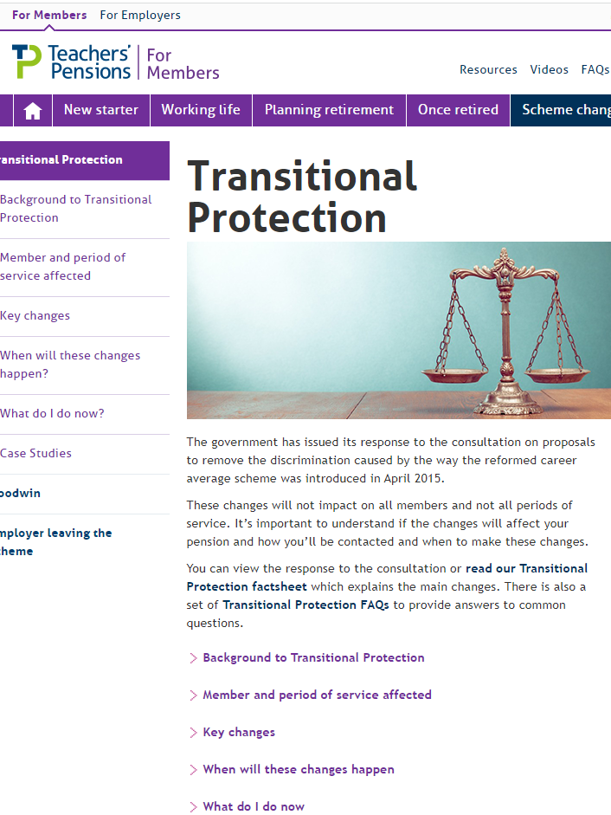
Transitional Protection developments
    MPO module
    Decision tree
    Introduction of personalised modeller
    Benefit statement developments/RSS Statement
    All underpinned by research from Focus Groups and stakeholders.

Slide 10
Help us, help you
  Have you got any ideas for engaging our members?
  What feedback do you receive from members about our communications?

Slide 11
Thank you

