Slide 1
Teachers’ Pensions Action Forum March 2022
Submission Support

Slide 2
Agenda
Service Submissions
Monthly Data Collection (MDC)
Monthly Contributions Reconciliation (MCR)
TR28’s
Contributions
Paying in slips
Calculation of contributions
Template updates

Slide 3
Service submissions
MDC
Delays in submitting
Missing members
No withdrawal ‘w’ indicator
Not submitting opted out members / putting down as all days excluded
Errors not being amended
TR28’s
Can only be used for service prior to on-boarding to MCR
Being used in place of MDC.

Slide 4
Monthly Contributions Reconciliation
What are Role Identifiers?
What are they used for?
How are they related to tiers for contributions?
Understanding the importance of keeping Role Identifiers the same throughout the member’s contract.

Slide 5
MCR Role Identifier
This field will be used to uniquely identify an “employment” and the role within an “employment”.
We currently do this on our systems by using the following sting of data:
This string is limited as a member can have multiple employments or multiple roles within an employment that would be submitted using the same Local Authority Number and Establishment Number (concurrent service).
The Role Identifier (RI) has been introduced to extend this string to allow us to record ‘Concurrent Service’ within the same Local Authority Number and Establishment Number without the need for employers to ‘roll up’ the service into one row of data.
Teachers’ Pensions Reference number
National Insurance number
Date of birth
Local Authority number
Establishment number
Role Identifier

Slide 6
MCR Role Identifier (continued)
The RI will be an employer generated reference that must contain two values separated by a ‘/’ symbol.
The first value will uniquely identify the “employment” and the second number the role within that “employment”.
We require both of these values to enable us to correctly validate the contribution calculations for members with different contractual arrangements. From analysis undertaken by us, there are two types of contractual arrangements a member could have:
Type 1 - A separate contract of employment for each job role a member has with an employer
Type 2 - A single contract of employment for all job roles a member has with an employer
As the contractual arrangement is not something we can determine, it’s up to an employer to decide which of these they have in place for their members and generate the RI accordingly.
Employment
/
Role within Employment
Role Identifier

Slide 7
MCR Role Identifier (continued)
Once the contractual arrangement has been determined for the member, the RI can be created for the different types as follows:
Type 1
The number before the ‘/’ MUST be different for each job role
The number after the ‘/’ can be the same or different for each job role.
Example
Member A has two separate job roles within a school. Each job role is treated as being a separate employment under their contractual arrangement with the school (Type 1).
You would therefore create two RI numbers, with the value before the ‘/’ beings unique for each:
Job Role 1 =
Job Role 2 =
1
/
1
1/1
2
1
2/1
/

Slide 8
MCR Role Identifier (continued)
Type 2
The number before the ‘/’ MUST be the same for each job role
The number after the ‘/’ MUST be different for each job role.
Example
Member B has two separate job roles within a school. Both job roles are treated as being a single employment under their contractual arrangement with the school (Type 2).
You would therefore create two RI numbers, with the value after the ‘/’ being unique for each:
Job Role 1 =
Job Role 2 =
1
/
1
1/1
1
1
1/2
/

Slide 9
MCR ‘When Earned’
How to use ‘When Earned’ indicators and the previously paid/adjustment columns for corrections
When earned must be used:
Performing a refund of contributions due to overpaid salary or retrospective opt out
Contribution deduction from a payment to a member in a pay month after the one in which the member left employment
Incorrect tier used
When Earned can be used at employer discretion, consistency must be shown
Used when an error has occurred in the member’s pensionable pay and the correction of using the standard “When Paid” method will cause the member to pay more contributions.

Slide 10
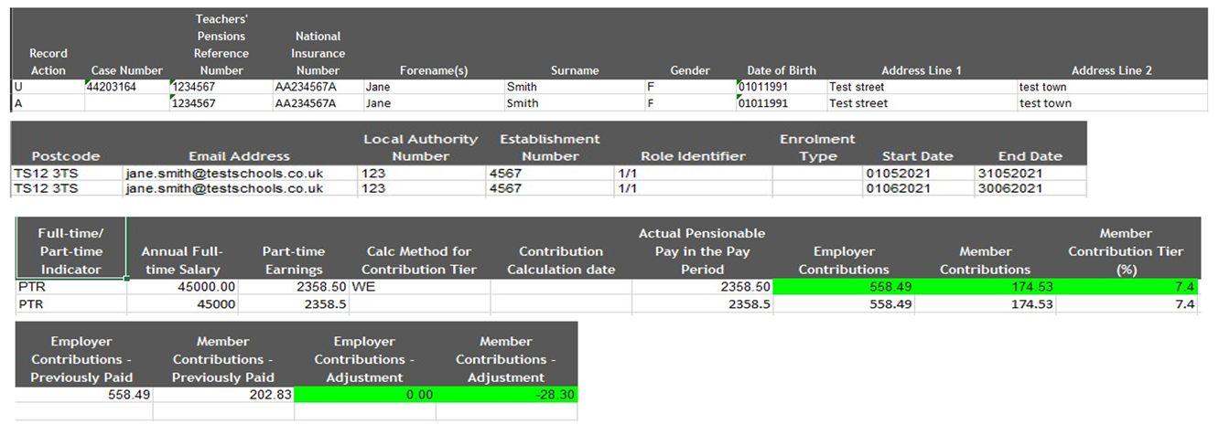
‘When Earned’ error correction
Not having the case number present for warning errors when correcting them – these can be found on the warning error file that gets returned to be corrected in the following months submission

Slide 11
Contributions
No paying in slip received/Payments received not matching paying in slip/MCR file
Based on each contract of employment a member has
Based on actual annualised earnings, not the full time salary rate
Refunds – when it is both ees and ers - on the breakdown form employer also needs to reduce the contributory salary by the relevant value too.

Slide 12
End of Year Certificate (EOYC)
Non receipts of form - both unaudited and audited
Totals not adding up correctly
Employers changing box 2D (contributions total) without consulting with TP as requested.

Slide 13
Template Macros
Microsoft is looking to change how macros are enabled in files from April 2022.
As a result of this, by default, macros will be disabled, previously we only needed to select the “enable content” option at the top of the program.
From April 2022, when an employer downloads the MCR template, MDC, Monthly Contribution Breakdown form, EOYC, Enrolment Template or TR28 template etc, by default the macros will be blocked. This is for files downloaded from the internet. The main reason for this is that macros are one of the biggest security risks regarding ransomware.
This will only be for the most recent version of office, but they are planning on rolling it out to previous versions.
More information can be found on the link here.

Slide 14
Template Macros (continued)
In order to enable macros, employers will need to download the file as they usually do and right-click the downloaded template.
Once done you will need to select “properties” and then “unblock”.

Slide 15
Thank you

