Slide 1
Teachers’ Pension Action Forum
MCR update

Slide 2
Agenda
        MCR on-boarding update
        How to on-board to MCR
        MCR learning materials and training
        Common errors during on-boarding
        Q&A

Slide 3
MCR on-boarding update
MCR on-boarding commenced in July 2020.
The first three months were limited to certain employers to trial the new solution.
This trial provided assurance that the solution was working as intended and we commenced with full on-boarding from October 2020.
To date we have on-boarded 688 employers with a further 1,620 providing a future on-boarding date.

Slide 4
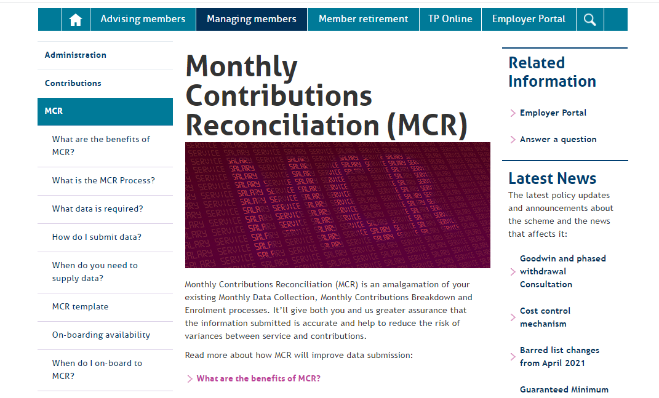
MCR on-boarding update (continued)
Successes
MCR Solution
Employer engagement
Improvements in data quality.
Challenges
Employer and provider preparedness
Unexpected error rates
Complexity of guidance.
Next Steps
Implement solution improvements
Continue to improve guidance and training.

Slide 5
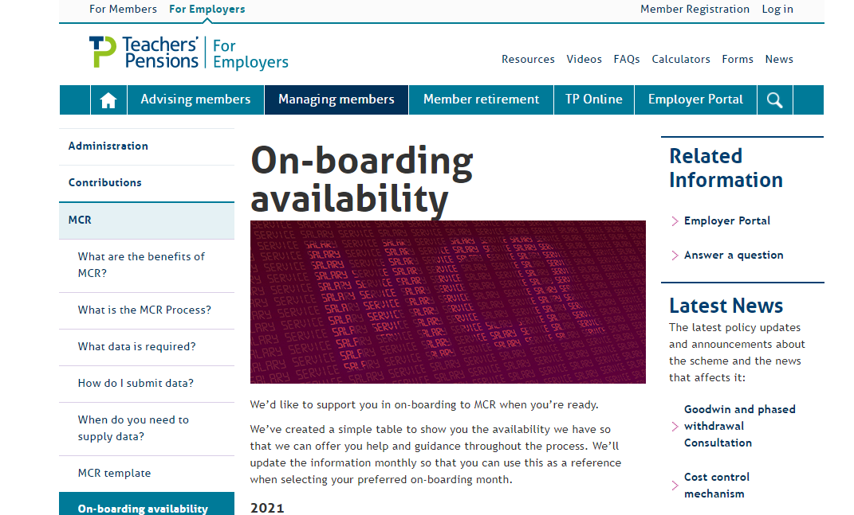
How to on-board to MCR
All employers must be on-boarded onto MCR by April 2022
We’ve a maximum number of employers we can accept each month between now and completion. Once capacity is reached within any given month, on-boarding will be closed
You can keep a track on the availability of on-boarding months on our website.

Slide 6
How to on-board to MCR (continued)
As we’re getting closer to the on-boarding deadline and can only on-board a limited number of employers each month, we need to get everyone booked onto the remaining months. To make sure you get the date you want, we need your completed On-boarding form to us by the end of June 2021
We’ll then allocate the remaining on-boarding slots available to those who’ve not provided us with their preferred date
An email campaign to support this message commenced last week.

Slide 7
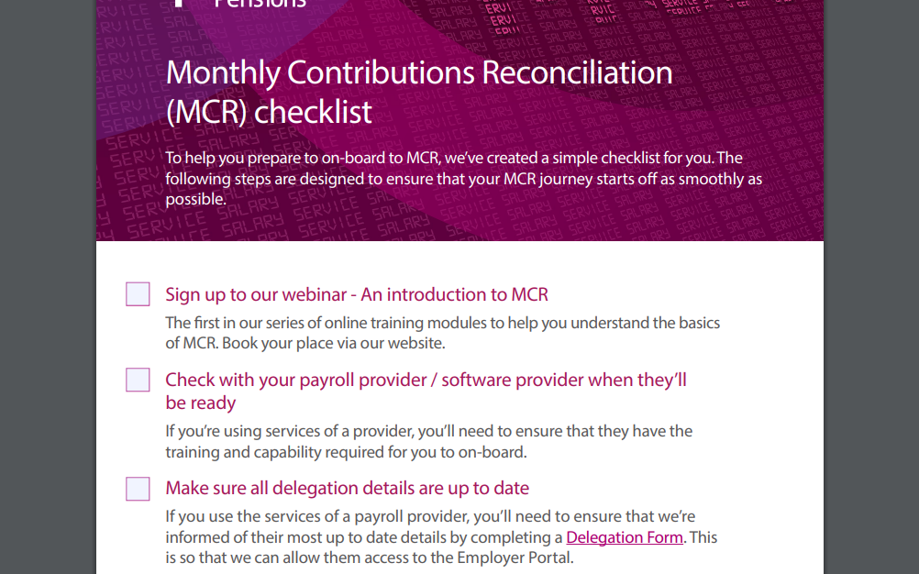
How to on-board to MCR (continued)
To assist employers with on-boarding, we’ve created a handy MCR On-boarding Checklist for you to follow
This highlights the steps we advise everyone takes before on-boarding to an MCR solution, and useful links to help you complete these steps
You’ll find this document on our website.

Slide 8
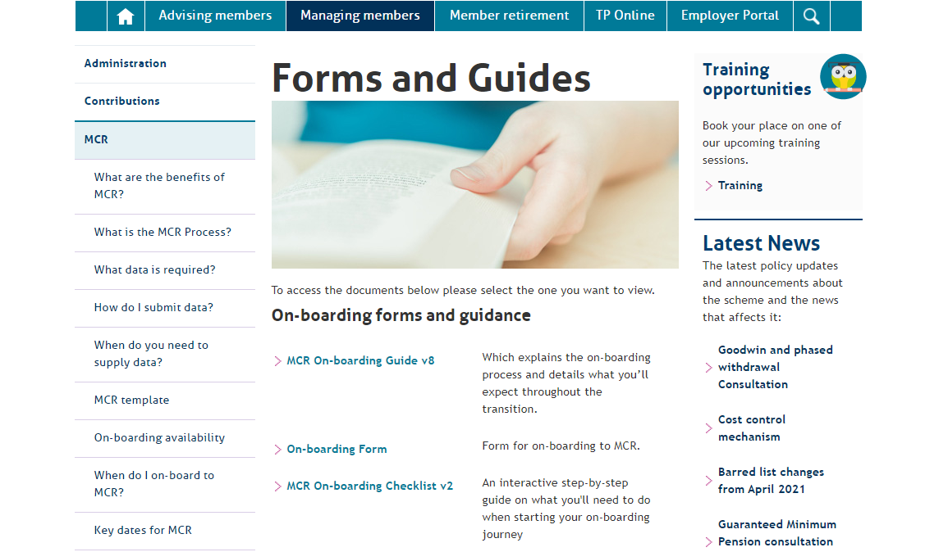
MCR learning materials and training
We’ve got lots of resources and training material for you on our website including:
      The On-boarding form
      The On-boarding Checklist
      Guides, including - an On-boarding Guide, a User Guide, the MCR template and user instructions
      We’ve got training webinars, including an introduction to MCR for those who are new to the Scheme, and an enhanced training programme for employers who are ready to on-board
      We’ve also got a training video and a benefits of MCR video which you can watch at your leisure.

Slide 9
Common errors during on-boarding
Opening MCR files in Excel
A dedicated import function has been developed within the MCR template to allow for comma-separated values (.csv) files to be reviewed and updated in the template.
We’ve noticed that some employers are opening the files we returned to them in Excel first, and then saving the file, which will corrupt the formatting of the data.
Excel will remove leading zeros and re-format some values such as the role identifier, which will mean the MCR template can’t read your submission when you try to import.

Slide 10
Common errors during on-boarding
Opening MCR files in Excel continued
To remove the risk of this issue, please make sure to use the ‘Save As’ option when downloading an MCR file we provide to you. Please make sure you don’t use the ‘Open’ option as this will cause the issue.
Once you’ve saved this file to your computer, please use the MCR template import function, then you can edit the file we’ve provided and produce a new output.

Slide 11
Common errors during on-boarding
‘Enrolment type’ field population
The ‘enrolment type’ field has been introduced to MCR to allow for automatic and contractual enrolments to be provided in a simpler way. Previously, this was completed using the enrolment template, which is a separate process.
We’ve noticed some of you have been providing enrolments for members who’ve not been automatically or contractually enrolled and, in some cases, provided enrolments for all members in a submission.
This causes issues, as you may have members who’ve opted-out of the Scheme and this “re-enrolment” means we now expect pension contributions to be provided.
Please ensure that you only provide ‘AUTO’ for automatic or ‘CONT’ for contractual enrolments if the member is enrolling on the start date for the service row.
If they’re not enrolling on this date, please leave the enrolment type field blank.

Slide 12
Common errors during on-boarding
Contribution calculation methods
We require a member’s contribution tier (only provide for members who are not on family or occupation sick leave, or who haven’t opted-out) to be determined based on the annualised pensionable pay paid in the pay period, excluding backdated pay and overtime.
This tier must then be applied to the pensionable pay paid in the pay period, plus any relating to backdated pay or overtime.
We’ve seen that some submissions haven’t used this rule when applying the contribution tier, for example, where the member’s annual salary rate has been used to determine the tier.

Slide 13
Common errors during on-boarding
Contribution calculation methods
This has implications for some members, such as if they’re mid-month starters or leavers, as they may be paying a high contribution tier than necessary.
Please ensure you read the MCR User Guide to ensure you’re deducting contributions correctly before making these deductions to your members.

Slide 14
Common errors during on-boarding
Reporting Backdated Pay Awards
We’ve identified during the on-boarding period, that people have found the reporting of backdated pay awards via MCR challenging.
To clarify, a backdated pay award is where a salary increase is awarded and is back dated to an earlier date. For example, you receive confirmation of a 2% pay increase for all teachers in your schools in November, which has been backed to 1st September.
When this occurs, we require service updates to be provided for the period the pay award relates to ensure the correct full-time salary (and part-time earnings if applicable) are recorded for the purposes of the member pension calculation, AND the additional contributions are taken using the correct calculation method for the arrears paid relating to that pay award.

Slide 15
Common errors during on-boarding
Reporting Backdated Pay Awards continued
Both of these MUST be done as part of your MCR submission following the pay award is processed to ensure no errors are identified. During on-boarding so far, a large number of errors have been generated as one or both of these requirements have not been followed correctly.
An example of how we expect the service to be recorded and the contribution calculation to be performed can be found the MCR User Guide with additional bespoke content being created to provide further guidance.

Slide 16
Common errors during on-boarding
Re-uploading error files
Two types of error file can be produced from an MCR submission: ‘warning files’; and ‘stop files’.
Both files can be imported into the MCR template for updates and changes to be made.
We’ve seen that some of you have tried to update these files and upload them without importing them into the MCR template.
This is a change compared to the prior Monthly Data Collection (MDC) process, where you could previously edit this file and re-upload.
Please make sure to import these error files into the MCR template and identify the relevant corrections from this. We’d then expect the relevant error corrections to be added to you next MCR submission.
Full details can be found on this process in the MCR User Guide.

Slide 17
Any questions?

