Slide 1
Future Development Workshop
Teachers’ Pensions Action Forum

Slide 2
Continuous Improvement Programme (CIP)
CIP activity was established to ensure ongoing improvements to the Teachers’ Pension Scheme, enhancing the employer and member experience.
Key principles of the initiatives:
Directly link to strategic objectives
Focus on experience outcomes e.g. CSAT Scores
Target simplification of employer and member journeys
Support ongoing digital transformation.

Slide 3
Continuous Improvement Programme (CIP)
To support this we want to take advantage of every opportunity to gather feedback from Employers to ensure initiatives:
Remain Fit For Purpose
Reflect Changing Employer landscape
Match the way members work.

Slide 4
Employer Portal
The Portal is a vital tool in ensuring employers can administrate the Teachers’ Pension Scheme effectively and successfully.
The CIP is also reviewing the functionality of the existing Employer Portal, ensuring:
The portal remains compliant with GDPR legislation
Maintains a high level of employer satisfaction
Reducing employer effort, subsequently reducing the need to contact the Teachers Pension Scheme
Improving the database structure, allow further improvements linked to Employer CRM, Dashboards and Risk Based Assurance.

Slide 5
Employer Portal
Particular areas of focus are (but not limited to):
Improving data transfer between employers to Teachers’ Pensions (and vice versa)
Member Search and Print improvements
User administration – creation, closure and management of portal accounts
Employer Dashboards - that details the progress on their outstanding tasks and provides useful information to help with their activities.

Slide 6
Authentication
Currently both members and employers are required to complete manual identification, this can be time consuming and frustrating
For members the infrequent use of their accounts drives password resets to the highest reason for contact.

Slide 7
Authentication
Teachers’ Pensions would like to:
Simplify web password approach. The research suggests retaining the full entry of the password, allowing device authentication for a longer period and to allow a PIN to be requested and sent to a mobile device
Reduce the number of steps required to reset the password to ease the effort required
Authenticated webchat (employer & member) to allow conversation to remain on line within the webchat channel.
Both Members and Employers have access to all of our channels, these channels will be brought together to provide a fully connected experience.
What else could we consider?

Slide 8
Knowledge Management System
Currently the call centre agents are supported by a basic knowledge management tool for FAQs and use the knowledge of their peers to answer complex scenarios
The Website has public facing FAQs which are limited in scope
We know there is an increased need for driving consistent responses to all users within a timely manner and believe a KMS would support this.

Slide 9
Risk Based Assurance
The provision of online based training to improve an employer and/or payroll providers understanding and subsequent administration of the Teachers’ Pension Scheme
Also provides the opportunity (linked with MCR) to monitor an employers ongoing monthly performance against a set of pre-defined measures – this acts as a prerequisite to the removal/streamlining of the EOYC process
This initiative would put in place a multi-tier accreditation scheme that would score payroll providers against a number of different criteria
We would use this accreditation scoring to encourage payroll providers to display the behaviours required for Teachers’ Pension Scheme to provide a high quality service to its members
Employers, on a monthly basis would be scored on their administration of tasks linked to data provision, data accuracy and finances
These measures will be weighted, based on employer size and used to determine a score – this score drives EOYC level.

Slide 10
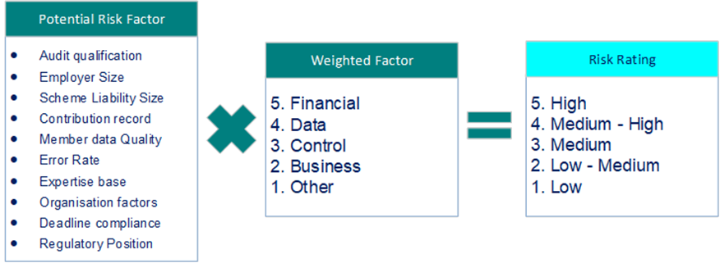
Risk Based Assurance
What measures could be used to determine compliance and good administration?

Slide 11
Knowledge Management System
Teachers’ Pensions would like to
Leverage the work Capita is doing to select a Knowledge Management (KM) tool to support employers, members and TP staff.
Deploy the KM tool:
Contact Centre
Back Office
DfE
Member Website
Employer Website
Use the KM to support Transitional Protection and Goodwin
What areas would employers like the KMS to cover?

Slide 12
Thank you
Notes:
Any questions?

