Slide 1
Teachers’ Pensions Action Forum June 2023
Submission Support

Slide 2
Agenda
File Submissions
Monthly Data Collection (MDC)
Monthly Contributions Reconciliation (MCR)
TR28’s.
Contributions
Paying in slips
Calculation of contributions.
Templates

Slide 3
MDC – common issues
Missing members
No withdrawal ‘w’ indicator
Errors not being amended
Data centre access
Uploading through incorrect Data Centre
Incorrect file name
Incorrect file format
Not submitting opted out members / putting down as all days excluded
Delays in submitting.

Slide 4
TR28’s
Can only be used for service prior to on-boarding to MCR
Being used in place of MDC
Salary scale code – W00.

Slide 5
MCR common issues/errors
Rejected MCR - suspended due to outstanding errors – the employer is not correcting their errors within the three-month period resulting in their submission being rejected as they have a suspended account
Incorrectly recording a Back dated pay award – have rolled the back dated pay into the actual pensionable pay, therefore the template believes the tier is incorrect – split the back pay over the months it relates too
Changing their MCR file to remove Amber errors prior to sending the submission despite the error being a genuine payroll mistake – this then causes a mismatch between the file and payment
Rejected MCR submission due to ‘Too Few Columns’ – this usually occurs when an MCR Submissions csv file has been opened outside of the template prior to uploading to the portal – You will need to save a new csv using the Template, please ensure not to open the file.
Recording family leave/sick pay and using incorrect notional pay – this can generate an incorrect tier
Any payment in lieu of notice to terminate a contract or any payment to cover the loss of any contractual holiday pay is non pensionable.
Notes:
Info from Lyndsay

Slide 6
MCR common issues/errors
Overtime rolled into actual pensionable pay as well as being in the overtime columns
Overtime only noted in Pensionable overtime column and not overtime column
Overflow/Mismatch 13 error – not using paste values to move data into the Template. Another cause is copying cells which appear to have no data but may have a ‘space’ inserted.
Notes:
Info from Lyndsay

Slide 7
Monthly Contributions Reconciliation
What are Role Identifiers?
What are they used for?
How are they related to tiers for contributions?
Understanding the importance of keeping Role Identifiers the same throughout the member’s contract.

Slide 8
MCR Role Identifier
This field will be used to uniquely identify an “employment” and the role within an “employment”.
We currently do this on our systems by using the following sting of data:
This string is limited as a member can have multiple employments or multiple roles within an employment that would be submitted using the same Local Authority Number and Establishment Number (concurrent service).
The Role Identifier (RI) has been introduced to extend this string to allow us to record ‘Concurrent Service’ within the same Local Authority Number and Establishment Number without the need for employers to ‘roll up’ the service into one row of data.
Teachers’ Pensions Reference number
National Insurance number
Date of birth
Local Authority number
Establishment number
Role Identifier

Slide 9
MCR Role Identifier (continued)
The RI will be an employer generated reference that must contain two values separated by a ‘/’ symbol.
The first value will uniquely identify the “employment” and the second number the role within that “employment”.
We require both of these values to enable us to correctly validate the contribution calculations for members with different contractual arrangements. From analysis undertaken by us, there are two types of contractual arrangements a member could have:
Type 1 - A separate contract of employment for each job role a member has with an employer
Type 2 - A single contract of employment for all job roles a member has with an employer
As the contractual arrangement is not something we can determine, it’s up to an employer to decide which of these they have in place for their members and generate the RI accordingly.
Employment
/
Role within Employment
Role Identifier

Slide 10
MCR Role Identifier (continued)
Once the contractual arrangement has been determined for the member, the RI can be created for the different types as follows:
Type 1
The number before the ‘/’ MUST be different for each job role
The number after the ‘/’ can be the same or different for each job role.
Example
Member A has two separate job roles within a school. Each job role is treated as being a separate employment under their contractual arrangement with the school (Type 1).
You would therefore create two RI numbers, with the value before the ‘/’ beings unique for each:
Job Role 1 =
Job Role 2 =
1
/
1
1/1
2
1
2/1
/

Slide 11
MCR Role Identifier (continued)
Type 2
The number before the ‘/’ MUST be the same for each job role
The number after the ‘/’ MUST be different for each job role.
Example
Member B has two separate job roles within a school. Both job roles are treated as being a single employment under their contractual arrangement with the school (Type 2).
You would therefore create two RI numbers, with the value after the ‘/’ being unique for each:
Job Role 1 =
Job Role 2 =
1
/
1
1/1
1
1
1/2
/

Slide 12
MCR ‘When Earned’
How to use ‘When Earned’ indicators and the previously paid/adjustment columns for corrections
When earned must be used:
Performing a refund of contributions due to overpaid salary or retrospective opt out
Contribution deduction from a payment to a member in a pay month after the one in which the member left employment
Incorrect tier used
When Earned can be used at employer discretion, consistency must be shown
Used when an error has occurred in the member’s pensionable pay and the correction of using the standard “When Paid” method will cause the member to pay more contributions.

Slide 13
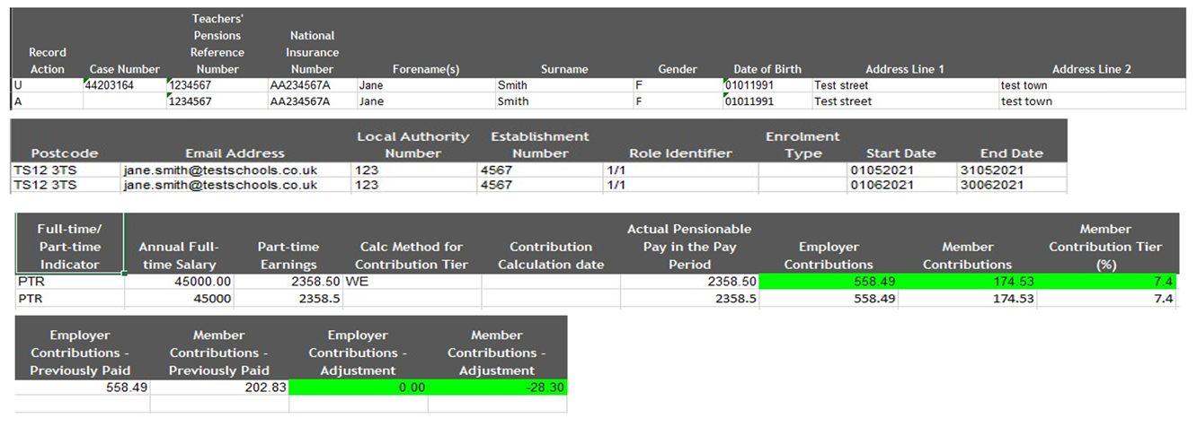
‘When Earned’ error correction
Not having the case number present for warning errors when correcting them – these can be found on the warning error file that gets returned to be corrected in the following months submission

Slide 14
Contributions
No paying in slip received/Payments received not matching paying in slip/MCR file
Based on each contract of employment a member has
Based on actual annualised earnings, not the full time salary rate
Refunds – when it is both ees and ers - on the breakdown form employer also needs to reduce the contributory salary by the relevant value too.
Notes:
Mention suspense

Slide 15
Contributions
Sick pay – pensionable provided the member is in receipt of at least 50% pay
Maternity pay - pensionable provided the member is in receipt of maternity pay or statutory maternity pay
For both sick and maternity pay the tier is based on the notional earnings and applied to actual earnings
Strike days – non pensionable

Slide 16
Templates
Please ensure you use the latest version of the templates
In order to enable macros, employers will need to download the file to a folder as they usually do and right-click the downloaded template.
Once done you will need to select “properties” and then “unblock”.
More information can be found on the link here

Slide 17
Thank you

